Slide 1
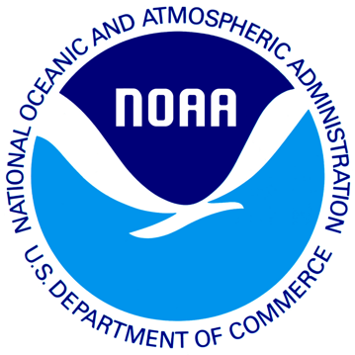




Intercomparison of the Southern Ocean Circulations in IPCC-AR5/CMIP5 Coupled Model Control Simulations
www.asoc.org
Jordan T. Abell,
Paul J. Goodman, and Joellen L. Russell
Department of Geosciences, University of Arizona, Tucson, AZ
25th Annual Arizona Space Grant Consortium Symposium, Tucson, AZ
April 16th 2016

Slide 2

Why the Southern Ocean?
1
It accounts for 67-98% of the excess heat that is transferred from
the atmosphere into the ocean each year.
Roemmich et al. 2015
2
It accounts for up to half of the annual oceanic uptake of anthropogenic
carbon dioxide from
the atmosphere.
Gruber et al. 2009, Landschützer et al. 2015
3
Vertical exchange in the Southern Ocean is responsible for supplying nutrients that fertilize three-quarters of the biological production in the global ocean north of 30°S.
Sarmiento et al. 2004

Slide 3
Why the Southern Ocean?
Talley/Olbers, 2014

Slide 4
Objectives
To develop consistent, observationally-based metrics to assess the fidelity of model simulations.
Create an online Southern Ocean Atlas to provide all ranges of people (from the non-coding scientific community to the general population) with the ability to compare climate models.
Using the figures, locate and quantify deviations of the models from observations in order to understand where the model is going wrong and why.

Slide 5
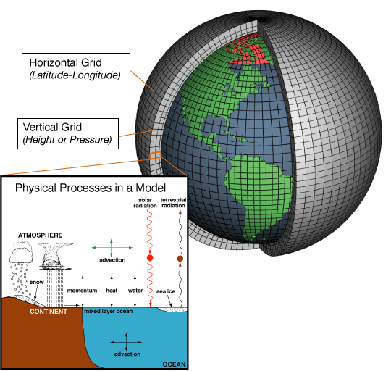
What is a Global Climate Model (GCM)?
A global climate model (GCM) is a complex mathematical representation of the major climate system components (atmosphere, land surface, ocean, and sea ice), and their interactions
Earth’s energy balance between the four components is the key to projections of future climate
Numerical models are the only quantitative means to project into the future.
www.noaa.gov

Slide 6
Southern Ocean Climate Model Atlas

Slide 7
What’s in the Atlas?
URL: http://southernocean.arizona.edu
Currently has polar plots of temperature, salinity, and dissolved inorganic carbon at 0m, 50m, 200m, 800m, 1500m, and 3500m
We have also completed the latitude vs. depth sections (30°E, 90°E, 145°E, 150°W, 105°W and 30°W) and the longitude vs. depth sections (70°S, 65°S, 60°S, 50°S, 40°S and 30°S).
Our next steps are to draft and post maps for mixed layer depth, heat content, nitrate, phosphate, and stratification in the ocean.
We will also be adding polar plots of sea ice extent and volume, and winds, clouds and air temperature in the atmosphere.

Slide 8
Coding with Ferret
Data Visualization and Analysis Software
Provided by NOAA
“Designed to meet the needs of oceanographers and meteorologists analyzing large and complex gridded data sets”
www.ferret.pmel.noaa.gov/

Slide 9
Temperature (°C)
Surface
Plots show the annual mean temperature at the surface.
Comparing the 0°C isotherm and the deepest blue color (< -1°C) in the surface figures.
Shows that ESM2M is too warm near Antarctica, while the CCSM4 and NorESM1-M models are too cold there.
World Ocean Atlas
CCSM4
ESM2M
HadGEM2-ES
NorESM1-M

Slide 10
Temperature (°C)
800m
Plots show the annual mean temperature at 800 meters.
The models accurately show the entrainment and advection of the warmest water from the Agulhas along the northern edge of the Antarctic Circumpolar Current (ACC).
Although, CCSM4 clearly has too much leakage into the Atlantic around Africa at this depth.
World Ocean Atlas
CCSM4
ESM2M
HadGEM2-ES
NorESM1-M

Slide 11
Temperature (Difference from Observed)
Surface
800 meters
CCSM4
ESM2M
CCSM4
ESM2M
HadGEM2-ES
NorESM1-M
HadGEM2-ES
NorESM1-M
The difference between the simulated field and the observed field (shown as model minus observed, so yellow/red (blue) indicates a temperature that is warmer (cooler) than observed) allows us to examine the spatial pattern of simulation “errors.”

Slide 12
Conclusions
  Created an online Atlas as a gateway for interested parties to compare standard maps of model simulations for the evaluation of the various models.
We developed consistent, observationally-based metrics to assess the fidelity of model simulations.
We present metrics related to circulation, wind-forcing, and water-mass properties that highlight the strengths and weaknesses of various simulations, as well as the similarities and differences between simulations.

Slide 13
Acknowledgements
Sources of Data
  Temperature/Salinity
    World Ocean Atlas 2009 http://www.nodc.noaa.gov/OC5/WOA09/pr_woa09.html
  Dissolved Inorganic Carbon
    GLODAP http://cdiac.ornl.gov/oceans/glodap/GlopDV.html
Members of the joint US CLIVAR / Ocean Carbon and Biogeochemistry Southern Ocean Working Group for their support and contributions to the development of the standardized metrics.
Program for Climate Model Diagnosis and Intercomparison for providing the climate model data used in the atlas.
Members of the NASA Space Grant. This work was funded in part by NSF Grant #1246247 and by NSF Grant #1425989.

Slide 14
Thank you!

